Slide 1
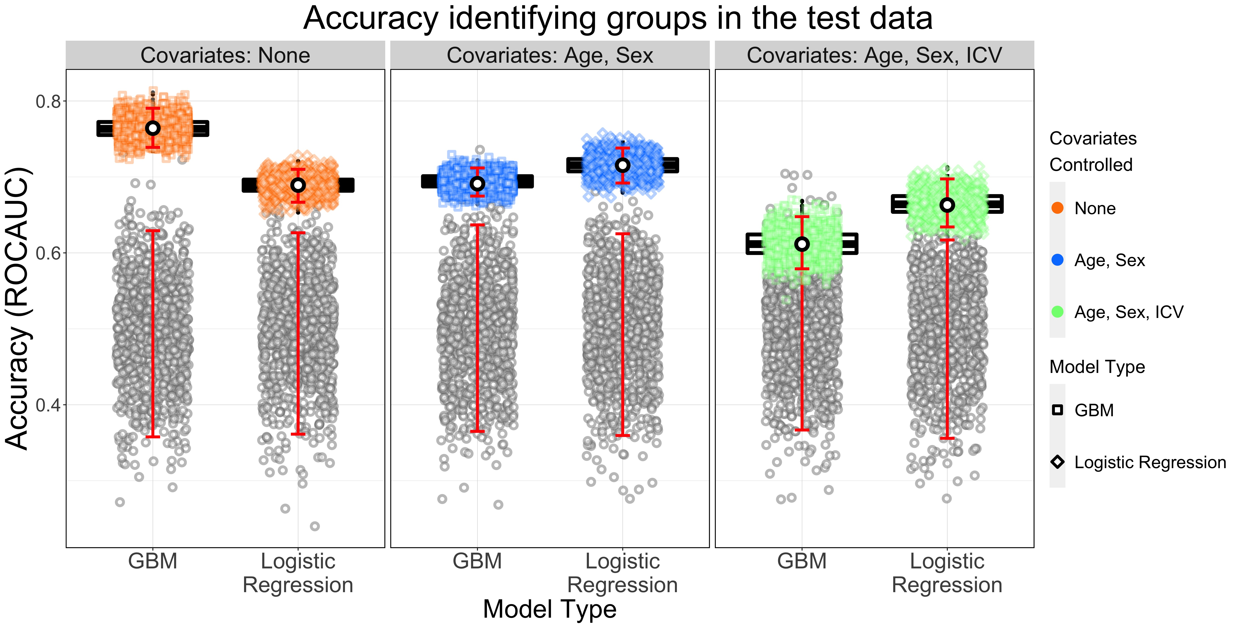
This plot contains the accuracy of each of the six models. The accuracy is the ROCAUC of the model, and is plotted as a white dot, outlined in black. Higher values of ROCAUC are plotted higher on the y-axis. Surrounding this dot are 1000, dots colored either in orange, blue, or green, that represent the ROCAUC derived when bootstrap resampling the test data (1000 times, with replacement), before calculating ROCAUC for the model. Contained in each bootstrap point cloud are is a red error bar encompassing 95% of that bootstrap distribution. To portray the median and quintiles of the bootstrap distribution, a boxplot is plotted behind the bootstrap distribution point cloud. The visualizations described above are distributed across three coordinate planes. Each shares the y-axis, representing ROCAUC, with one column for the gradient boosting machine model on the left, and another for the logistic regression model on the right. Both models in each plane reflect the abovementioned statistics from the two models labelled on the x-axis when utilizing the dataset adjusted by the covariates listed in the title of the plane, and in the key pertaining to the color-coding. Finally, the grey point clouds represent the null distribution of model accuracies (in ROCAUC) pertaining to the model just above it (along the y-ais). The red line therein portrays the region in which 95% of the null values exist. A model is significant when the white, black-outlined dot exceeds 95% null region.

Slide 2
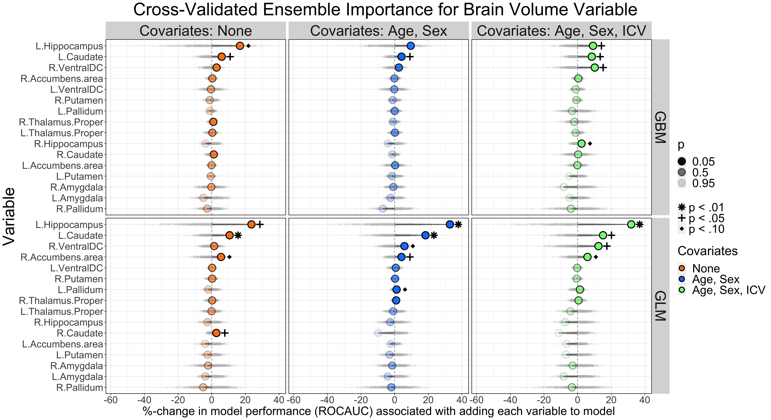
This plot contains the importance of each variable in the model. The importance of each variable is the percent by which the model improves, because that variables was in the model. Since our models are evaluated using ROCAUC, each variable’s importance is the percent of the total ROCAUC attributable to that variable. More rightward on the x-axis is a larger percent of the model’s ROCAUC, and each variable is listed on a new row of the y-axis. The grey shadow appearing on each variable’s row (typically centered near 0) is a composed of 1000 null variable importance values generated for that variable under 1000 simulations under conditions in which the null hypothesis were true. The level of significance of each variable importance is signified by a shape, either an asterisk, a plus sign, or 10-pointed star. The transparency of each dot also portrays the significance level, where more transparency is associated with a higher p-value, and opacity is associated with a p-value of 0. These images are repeated on six coordinate planes, each representing a different model and dataset. Here, the three planes on the top row pertain to the gradient boosting models (GBM), whereas the logistic regression or generalized linear model (GLM) are plotted on the bottom row. Each column pertains to a different dataset. The most leftward is the dataset containing subcortical grey matter volume, the middle column contains the plots pertaining to the models using the subcortical grey matter volume variables adjusted for age and sex, and the final column is adjusted for age, sex, and ICV.

Slide 3
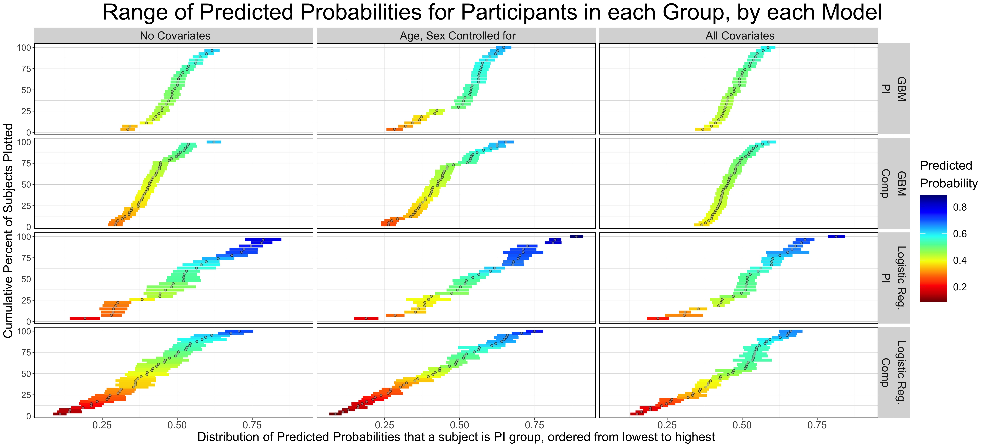
These plots show each subject’s predicted probability, predicted by each model, that the subject is part of the PI group. Those probabilities are plotted on the x-axis of each of the twelve coordinate planes. The subjects’ predicted probabilities are sorted from lowest to highest, so that the first subject plotted the furthest to the left on the x-axis was assigned the lowest probability by the model pertaining to that plane. As a result, as you move upward on the y-axis and rightward on the x-axis, an incrementally larger proportion of subjects will be plotted on the graph, until all subjects’ predicted values of x appear. The value of x when y is 50% therefore represents the median value for the distribution of the values on the x-axis. The curvature of the line overall is a representation of the spread of the distribution. The values on the x-axis are also color-coded, where a probability of 0 is red, and 1 is blue. The width of the line around each subject’s dot represents the 95% confidence interval of that probability generated by the model. The distributions of each of the six models (two model-types by three covariate-adjustment pipelines) are further separated by the subject’s actual group (PI or COMP), to facilitate comparisons of the predicted probabilities for each group, by each model.

